Slide 1
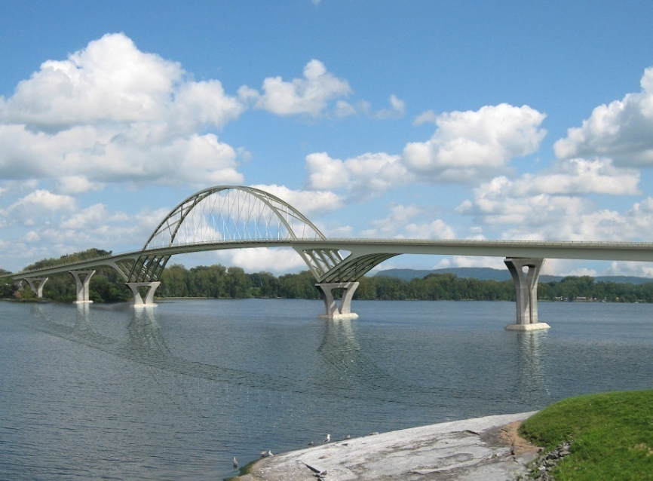
The Lake Champlain Bridge
A Look Back and to the Future

Slide 2
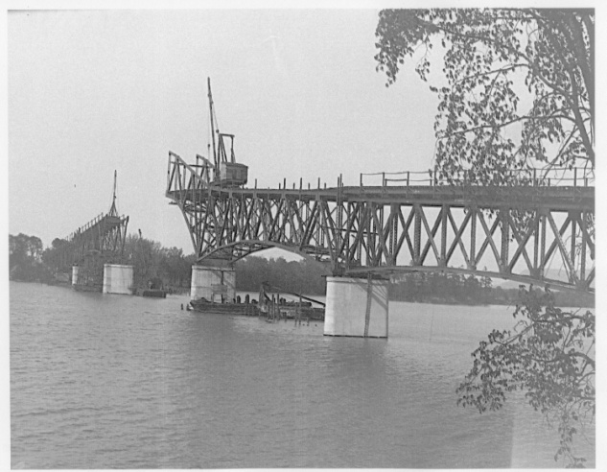
A Look Back
1929 Lake Champlain Bridge
Designed by Charles M. Spofford of Fay, Spoffard and Thorndike
Renowned bridge designer, early pioneer of continuous truss design
One of the first highways using a long-span continuous truss
2187 feet long Continuous truss
434 foot half-thru truss main span
5 deck truss spans
8 short steel girder spans
95 feet typical clearance over water
Listed on the National Historic Register
Designated as a National Engineering
Landmark

Slide 3
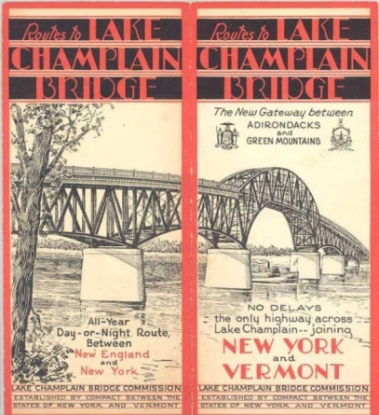
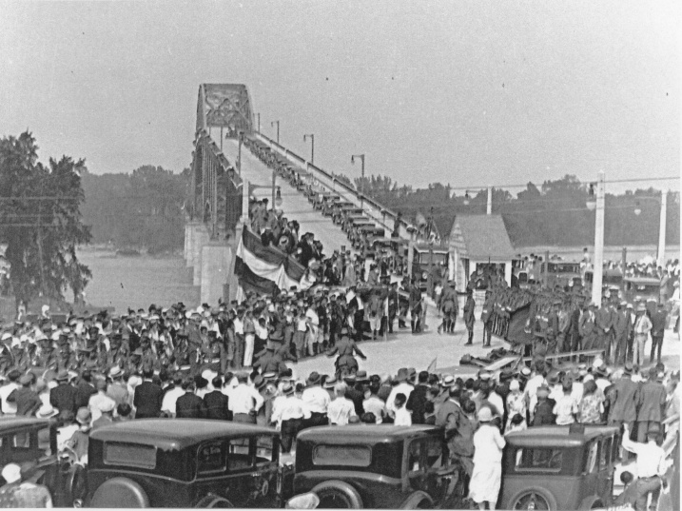
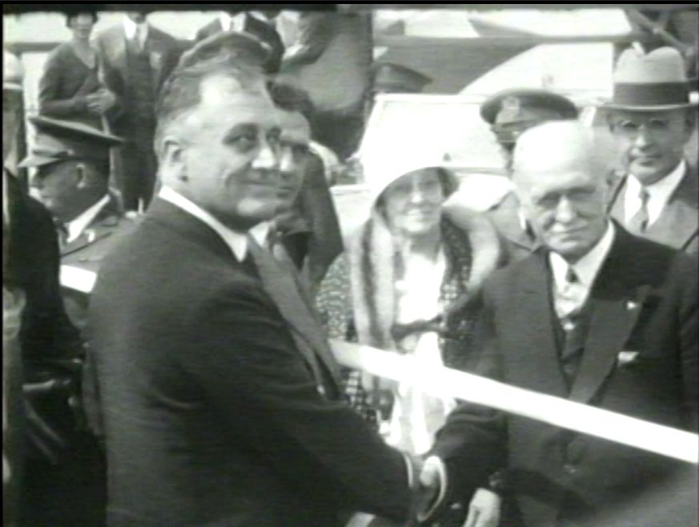
Opened to traffic in August 26, 1929 after only 14 months of construction
Original total cost of $ 1,149,000
Jointly owned by NY and VT
Operated by the Lake Champlain Bridge Commission until 1987

Slide 4
Unusual Design & Construction Aspects
of the Lake Champlain Bridge
Slender unreinforced concrete piers
Iron-ore tailings for concrete aggregate
Concrete joints not keyed in – Cold Joints
No pier armor to protect against ice
abrasion
Caisson placement with patented drop-bottom bucket

Slide 5
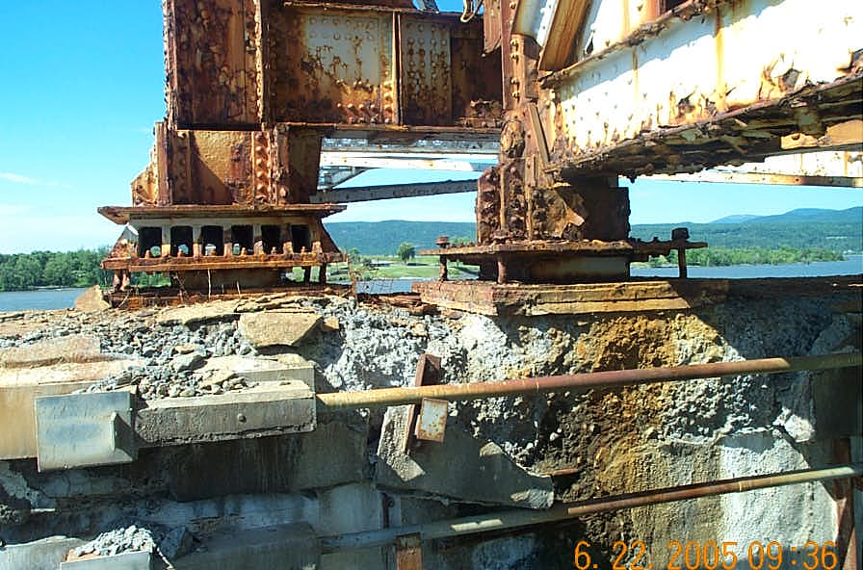
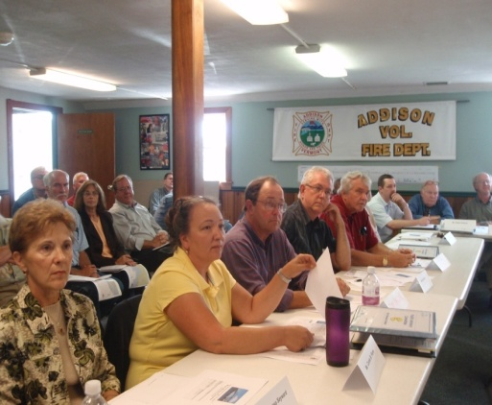
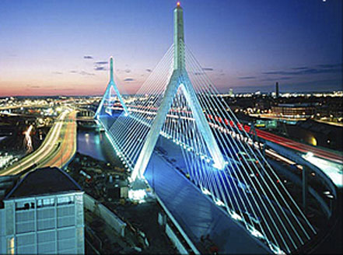
The Beginnings of the New
Lake Champlain Bridge
1987 - New York & Vermont take over ownership from
LCB Commission. New York is named lead
Agency for LCB and VT the lead on the Rouses
Point Bridge.
2005 – VTrans and NYSDOT meet to discuss the future
of the bridge and agree to rehabilitate or replace.
2007 - Public Action Committee formed.
2009 - Bi-State Agreement executed in June.
2009 - HNTB selected as Engineering Design Consultant
Tom Potts – Project Manager
Ted Zoli – Chief Designer

Slide 6
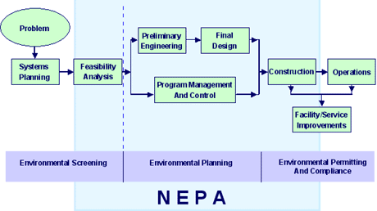
Project Development Process
Scoping to determine resources
Evaluation of impacts to resources
Environmental Impact Statement
Preliminary Design
Environmental Permitting
Final Design and Right-of-Way
Contract plans and Specs
Construction
Typically 6 to 7 year Process

Slide 7
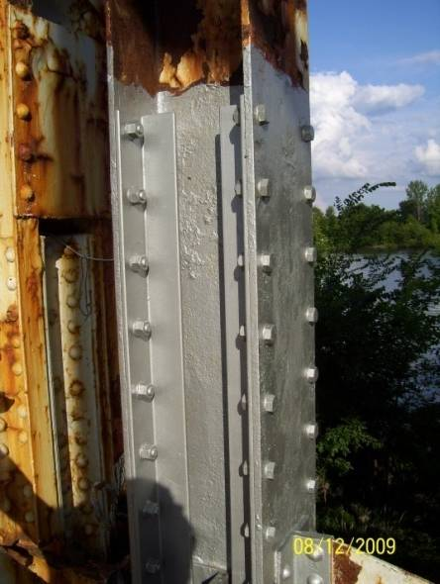
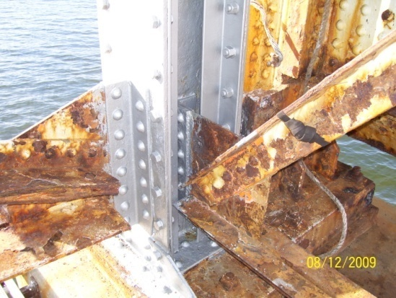
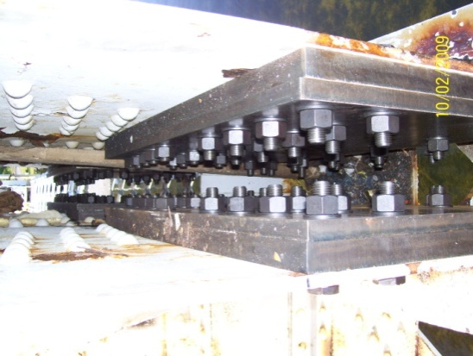
Emergency Steel Repairs
In the summer of 2009 the bridge was reduced to one lane traffic and emergency repairs were made to the superstructure.

Slide 8
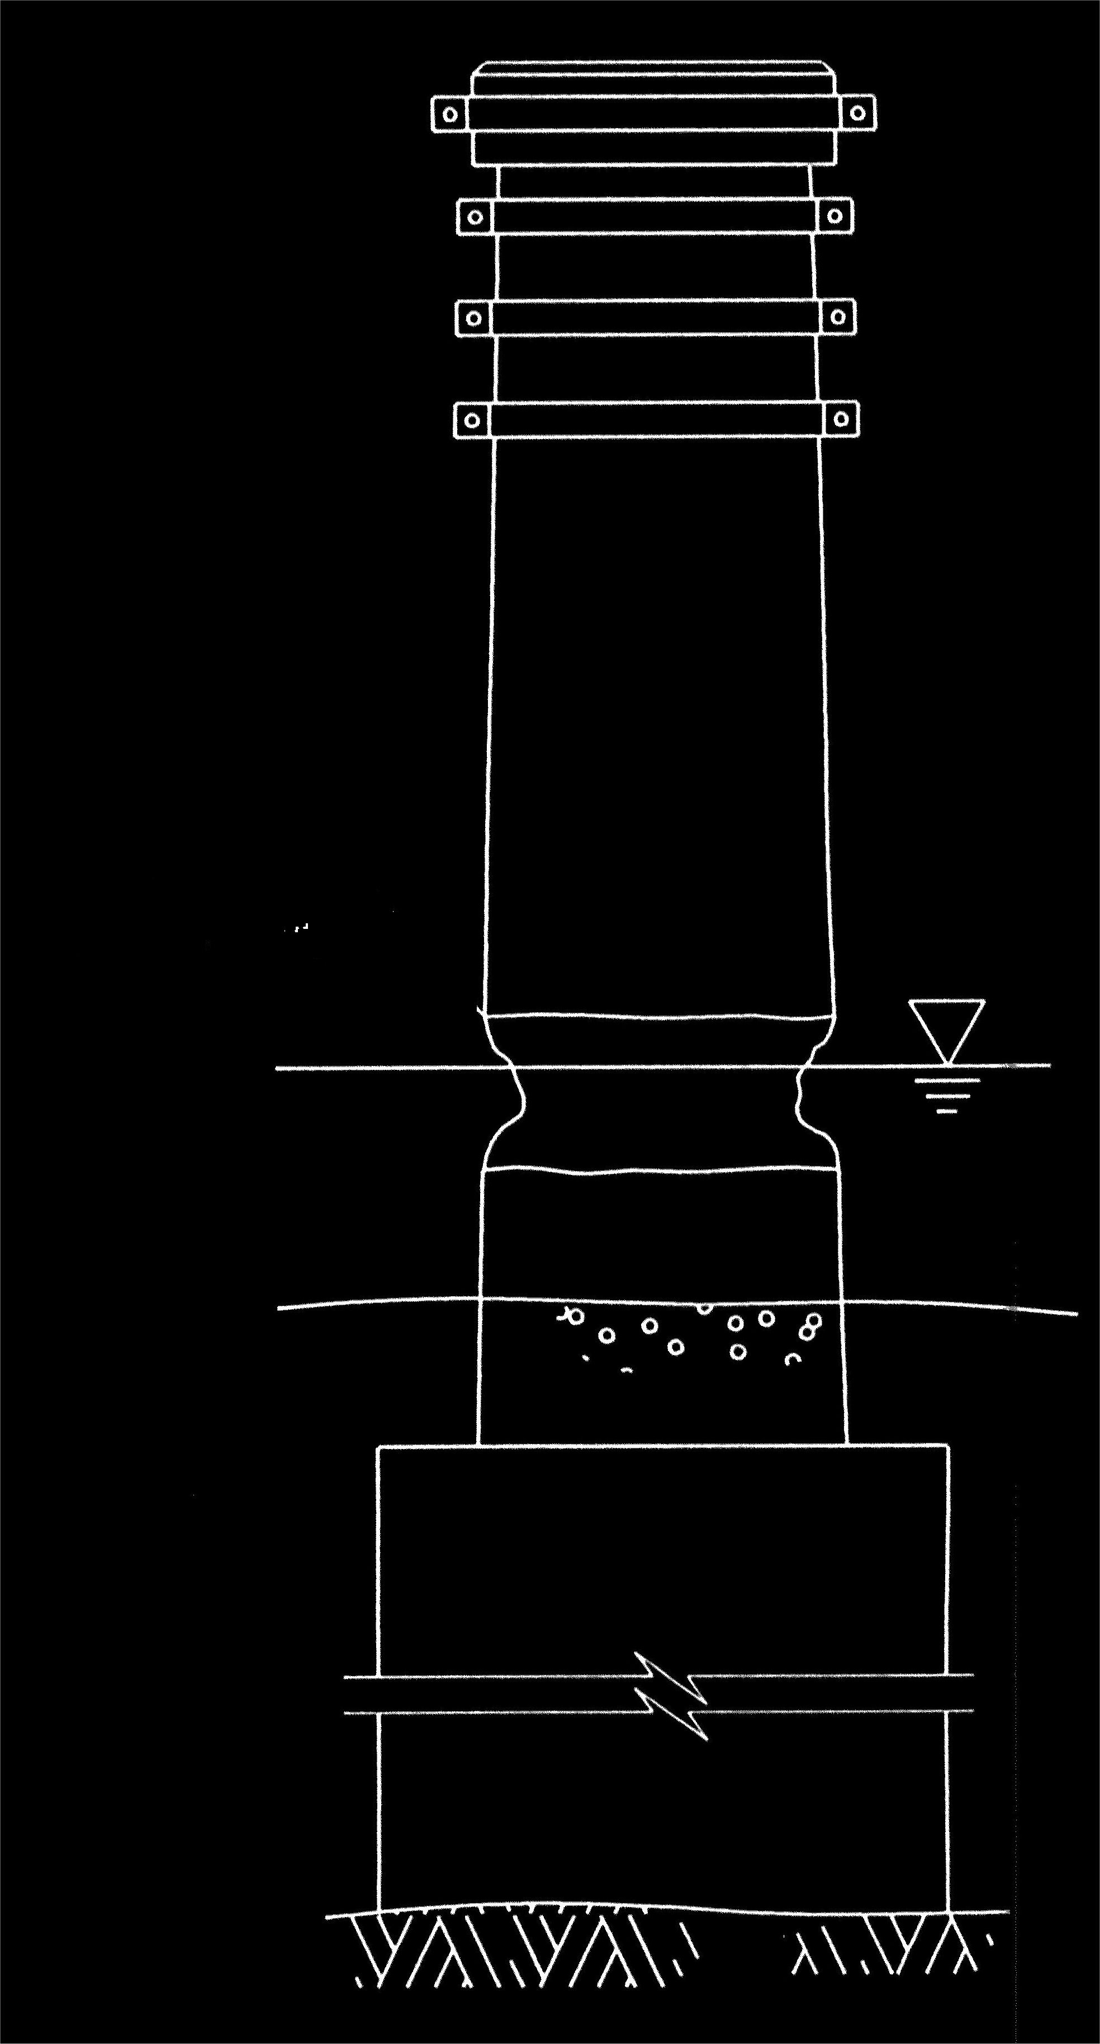
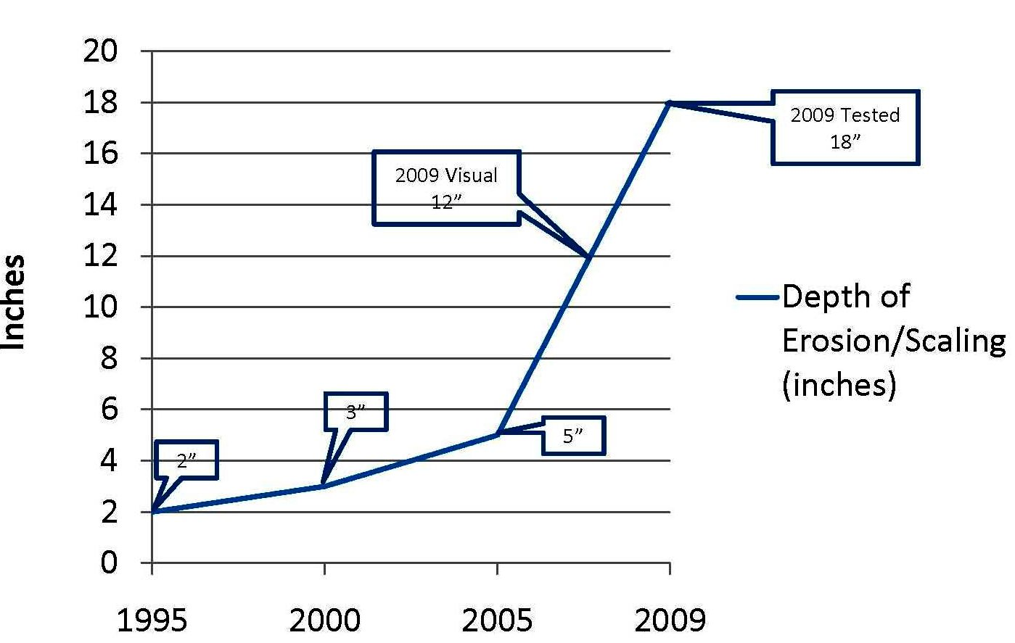
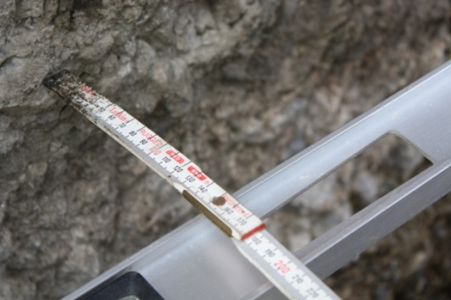
Observations at Pier 5:
18" Section Loss Below Water Line
Notes:
ADD PIER THICKNESS

Slide 9
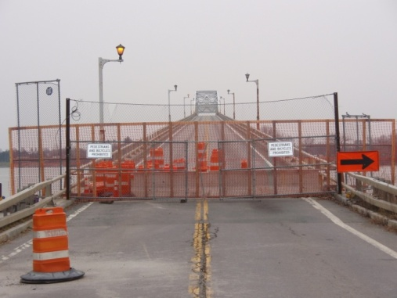
Bridge Closed on October 16, 2009 at 1:30 PM and Declares a State of Emergency.
Immediate Reaction from Public
Panic – People stranded on both sides of the lake.
Fear – How do I get to work.
Will I lose my job.
How am I going to pay for added costs.
Frustration – Why don’t they do something?
Total loss of confidence in State government
How could they let this happen?
They don’t care about us.

Slide 10
Impacts
To the General Public
Added travel time
Increased cost for fuel, day care , and ferry service
Layoffs
To Government Services
Medical both care facilities, emergency
services including ambulance and fire protection.
To Business
Loss of Business
Tourism
Increased Trucking costs
Farming

Slide 11
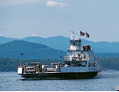
The immediate Problem.
How Do You People get Around the Lake with the Bridge Closed ?
By Vehicle – Approximately a 90 mile detour through Whitehall, New York.
By Ferry @ Port Charlotte, Vermont To/from Essex, New York. Can be operational all year. Daily schedule from 6:00 AM to 10:00 PM.
By Seasonal Ferry @ Ticonderoga, New York.
Operational from June 16th to October 31st.

Slide 12
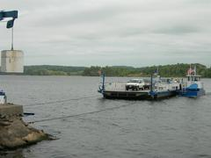
What Short Term Solutions will Solve the Immediate Crisis?
Improve Ferry Service @ Port Charlotte/Essex – 24 – 7
Improve Ft. Ticonderoga Ferry service to Lengthen Season
Add a New Ferry Service
Add a Pedestrian Ferry Service
Subsidize the existing and New Ferries
Public Transit
Shuttle Service

Slide 13
Time to Face the Music
Meet with Public @ West Addison Central School & Moriah Central School
October 27th & 28th
Tell them why it had to be closed
Listen to their concerns
Tell them what we intend to do
Reaction
Approximately 900 People Attended
Public let it be known. They wanted a new Bridge NOW!

Slide 14
Can the Bridge Be Repaired and Reopened?
Concerns
Weather Conditions – Already late October
Safety of Workers making repairs
Depth of the Water
How Long will it take to complete repairs
What will it cost – Cost Benefit Ratio
HNTB Completes the Final Safety Assessment Report
December 3, 2009
Consultant recommends that rehabilitation options should be dismissed
from further study.

Slide 15
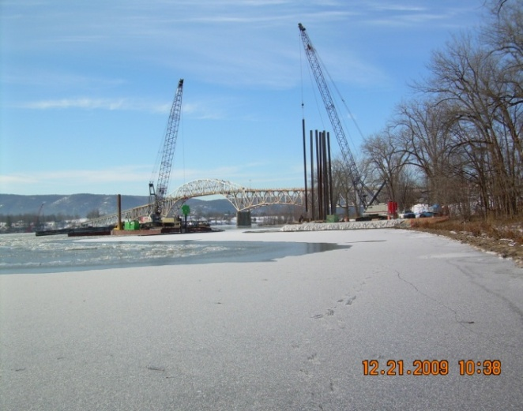
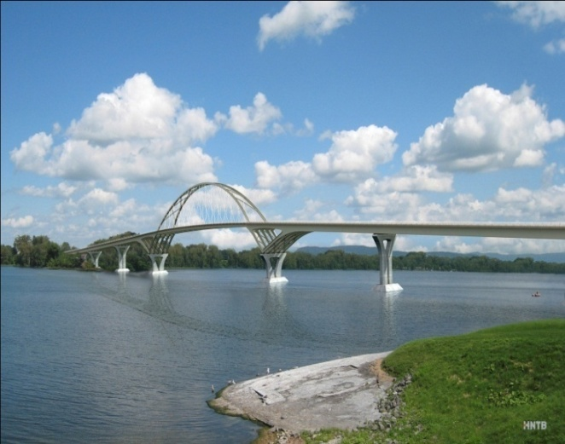
Immediate Response By VTrans/NYSDOT
Five New Projects Initiated & One Accelerated
Sign & Maintain Detour Project – Both States to Lead
Provide Temporary Transportation – Both States to Lead
Demolish the Old Bridge – New York To Lead
Build a New Temporary Ferry at a location TBD - Vermont to Lead
Operate the Temporary Ferry until a New Bridge is Built – Vermont to Lead
Accelerate the Design of the New Lake Champlain Bridge – Both states

Slide 16
December 28, 2009

Slide 17
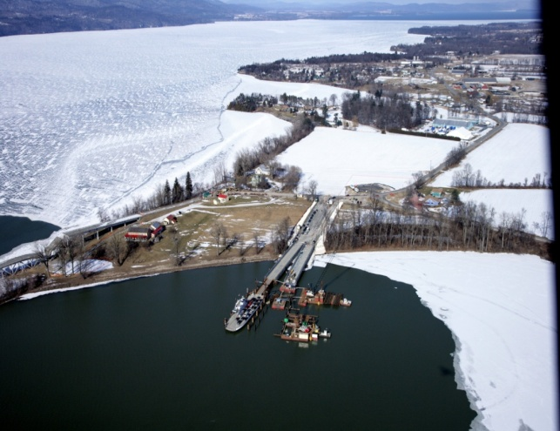
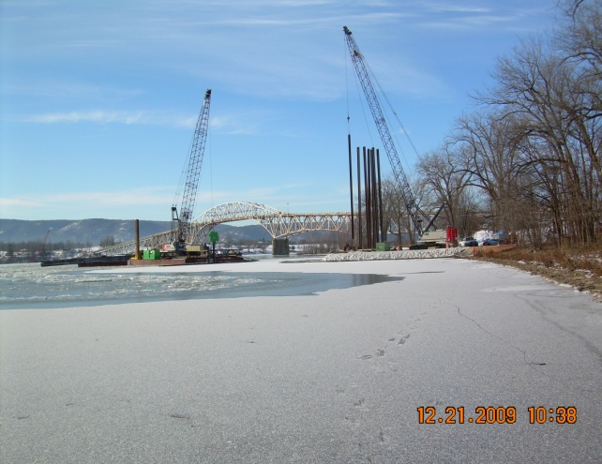
Temporary Ferry
Five Sites Investigated – Chimney Point near Bridge Selected
Permitting & Clearances completed in late October
w/Final Design following.
Lake Champlain Transportation Selected
Five Contractors Pre-Selected to bid
Kubricky Construction Selected November 29th
Construction Completed and Opened to Public @ 5 AM
On February 1, 2010

Slide 18
The Design of the New Bridge
1929 LCB
2011 LCB

Slide 19
Project Development Process
Scoping to determine resources
Evaluation of impacts to resources
Environmental Impact Statement
Preliminary Design
Environmental Permitting
Final Design and Right-of-Way
Contract plans and Specs
Construction
Typically 6 to 7 year Process
now a 5 month process

Slide 20
Step One - Decide on a Design Concept
Maximize User Safety
Aggressive Design & Construction Schedule – 500 Days
A Minimum Service Life of 75 Years
Minimize Maintenance & Inspection Costs
Minimize Costs
Select a Bridge Type that would be acceptable to the Public

Slide 21
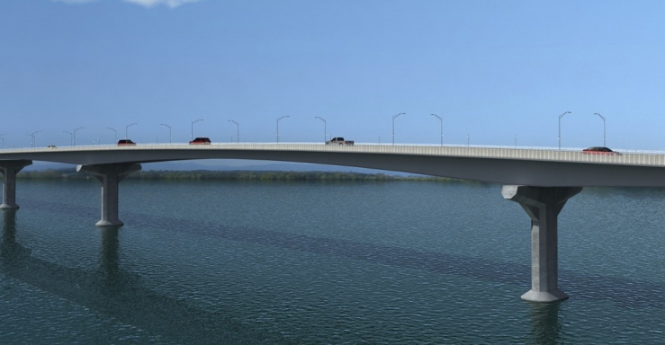
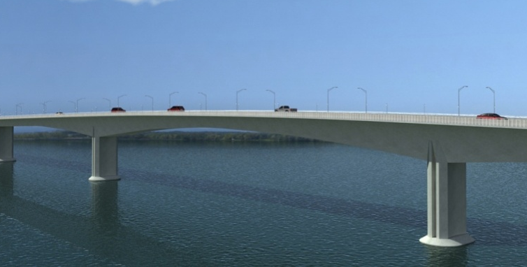
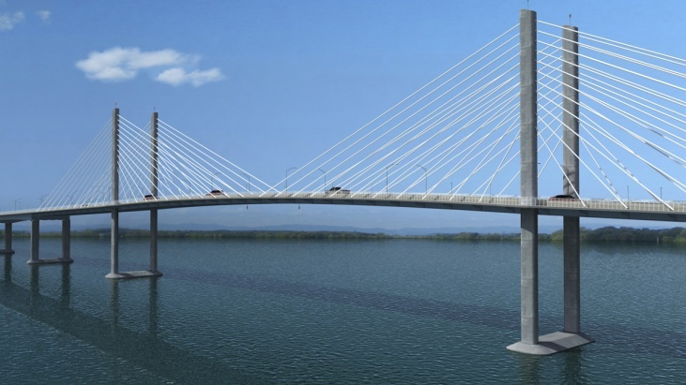
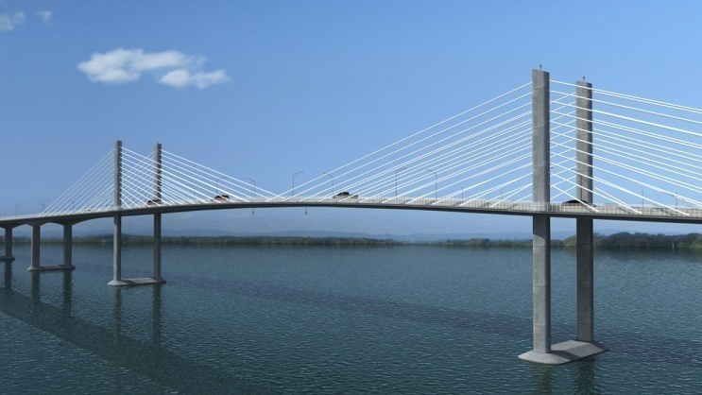
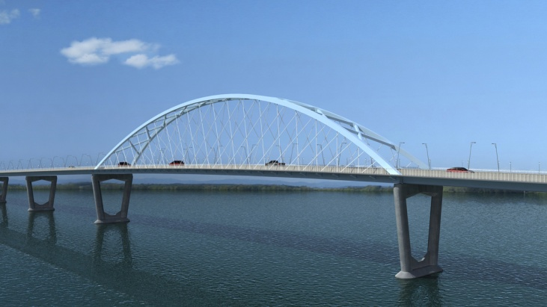
Initial Bridge Types
Steel Girder
Segmental Box
Cable Stayed
Extradosed
Network Arch

Slide 22
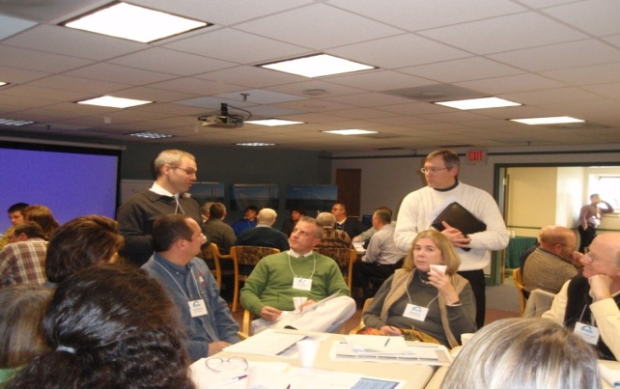
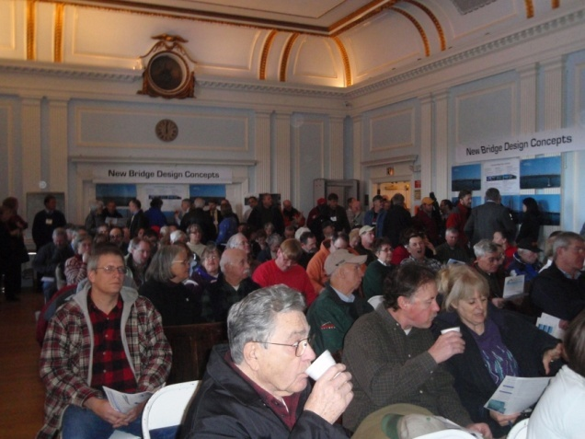
Step Two - Get Public By-In
Six Day Public Process in December - 30 day Comment Period
Day 1 – Meet with Section 106 Stakeholders
and Present Bridge Type Alternatives
Day 2 – Project Action Committee & Charrette
Day 3 & 4 – Series of Public Meetings in
Ticonderoga, New York
Day 4 & 5 – On-line Survey
Day 6 – VTrans & NYSDOT Announce Findings

Slide 23
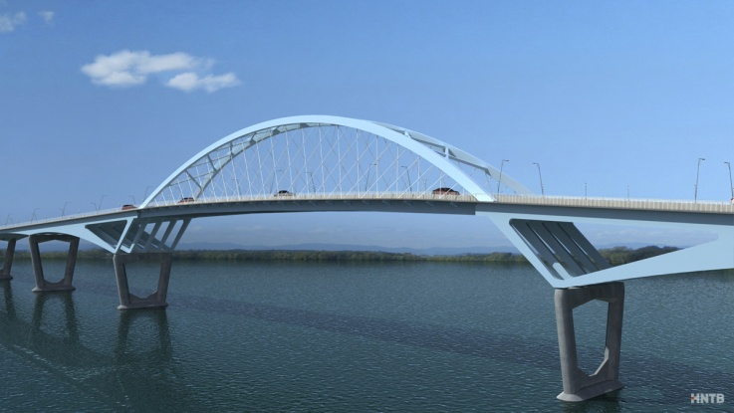
Day 1 Section 106 Stakeholders Recommends a New Bridge Type
Modified Network Arch

Slide 24
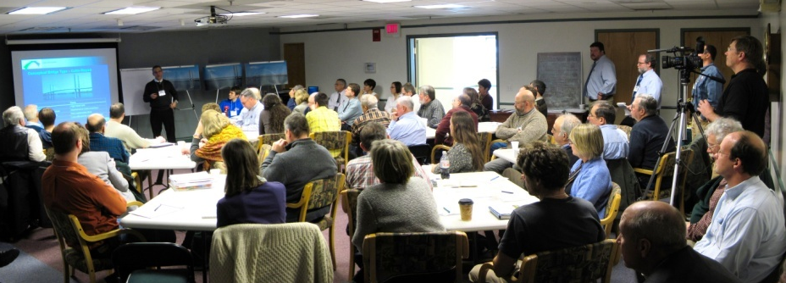
Day 2 PAC Unanimously Approves a Resolution to Adopt the Modified Network Arch Bridge Type
Day 3, and 4 Public Meetings in Ticonderoga, New York and Survey
Day 5 Online Survey Continues

Slide 25
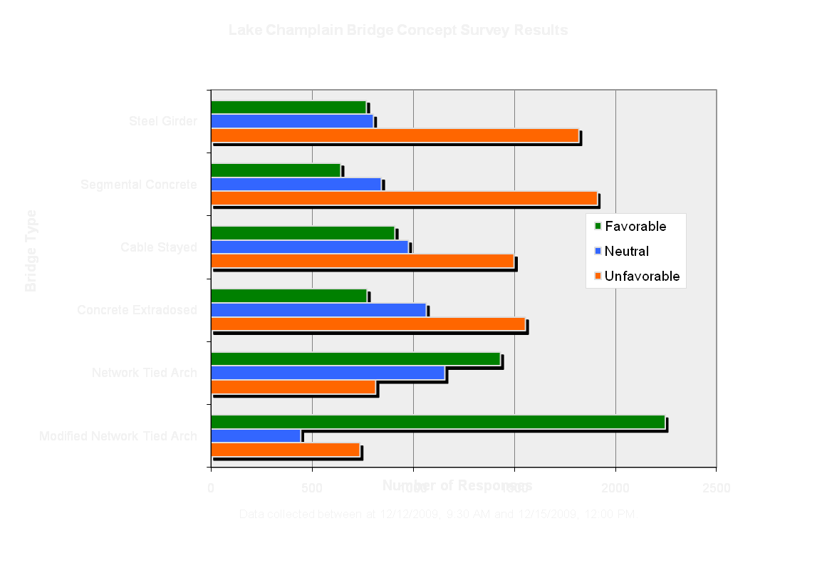
Survey Results – 3270 responses
Steel Girder
Concrete Segmental
Cable Stayed
Concrete Extradosed
Network Ties Arch
Modified Network Ties Arch

Slide 26
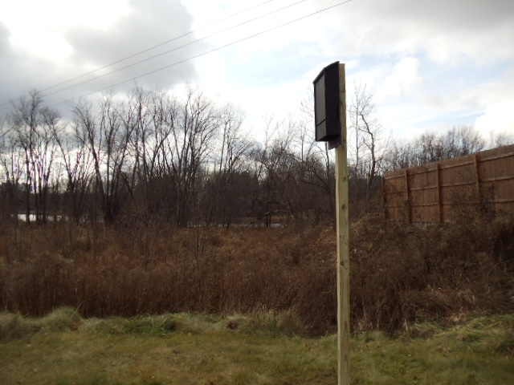
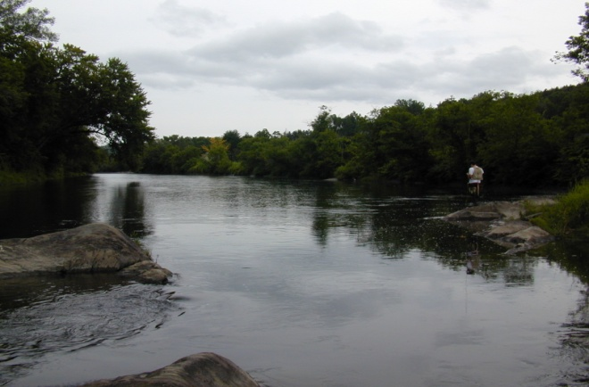
Step Three – Confer with Regulatory Agencies
Agency of Natural Resources
Wetlands
Threatened & Endanger Species
Water Quality
NEPDES
Department of Historic Preservation
Archeology
Historic Preservation
U.S. Army Corp of Engineers
401 Corps Permit
U.S. Coast Guard
Bridge Permit

Slide 27
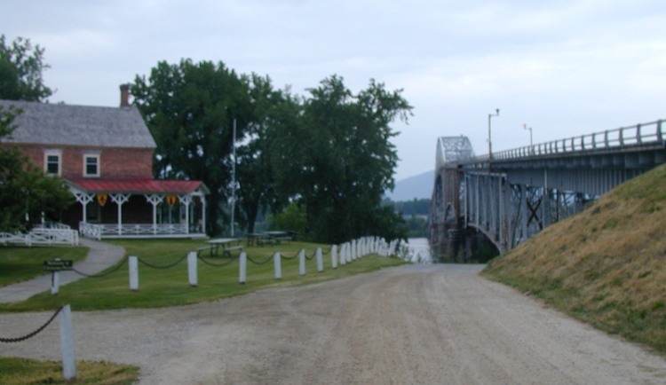
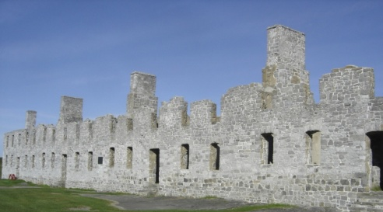
Step Four – Permitting & Design
Design Considerations 6(f) and 4(f)
Incredibly rich cultural resources on both sides
Rich Archeological areas on both sides
French Fort (1731) on Vermont Approach
Chimney Point Historic Site
Fort St. Frederic (1734)
Fort Montgomery (1759)
Toll Keepers House
Campground – National Historic register
Lake Champlain Lighthouse (Rodin sculpture)
Historic Residence
Fish & game Boat Launch on Vermont Approach

Slide 28
Permit Complications
Two States
Environmental Regulations vary (ANR & DEC)
Land Use (Act 250 & Adirondack Park Agency)
Two Federal Regions
Federal Highway Administration (Vermont & New York)
Corps Of Engineers (New England District & New York District)
Right- of-Laws
Vermont Necessity Law – New York Condemnation
6(f) & 4(f)
40 Section 106 Consulting parties

Slide 29
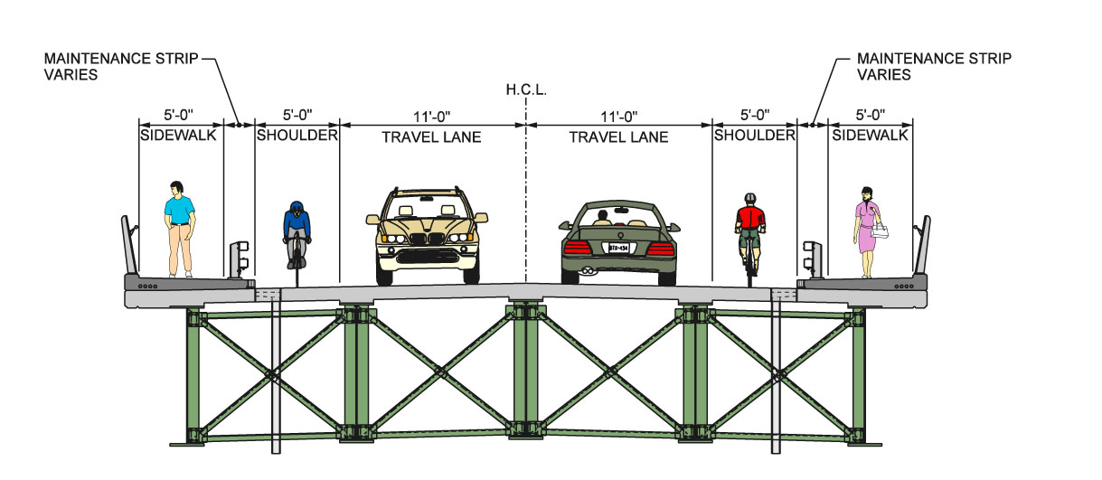
Required Design Features
To meet or exceed the existing structure functionality
(2) 11’ wide lanes
(2) 5’ wide shoulders
(2) 5’ wide sidewalks
ADA Compliant
Aesthetically pleasing structure
Meet current loading and clearance requirements
Over 17’-0” vertical vehicular clearance
75’-0” vertical navigational clearance
Meets replica schooner Lois McClure mast height
Exceeds Rouse’s Point vertical clearance
Minimum 75-year service life

Slide 30
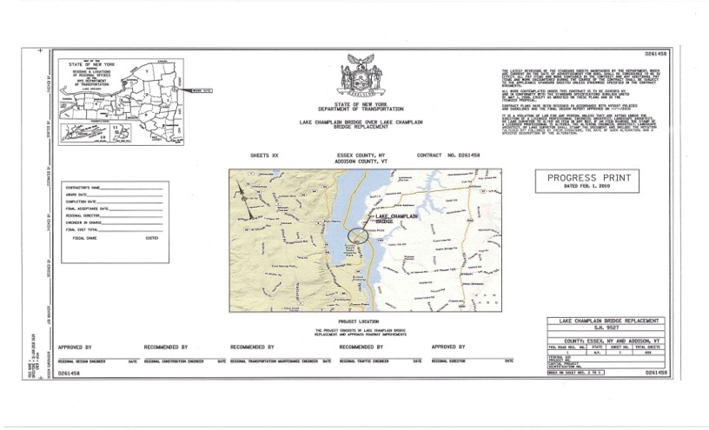
Design Schedule
Typical 6 to 7 Year Project Development Process Reduced to 5 Months
Conceptual Plans (10 % Plans) – January 6, 2009
Intermediate Design Plans (30 % Plans) – Met with
Contractors - January 25, 2010
75 % PS&E for Bid ( Four Week Advertisement –
March 1, 2010 – Plans posted on the Web
95 % PS&E Amendment # 1 – March 29, 2010 –
100 % PS&E Amendment #2 – April 1, 2010 – Pre- Bid Meeting
Bids Due – April 15, 2010 (8 Bidders)
Contract Award to Flatiron Construction Corporation for $ 69.6 M – May 27, 2010

Slide 31
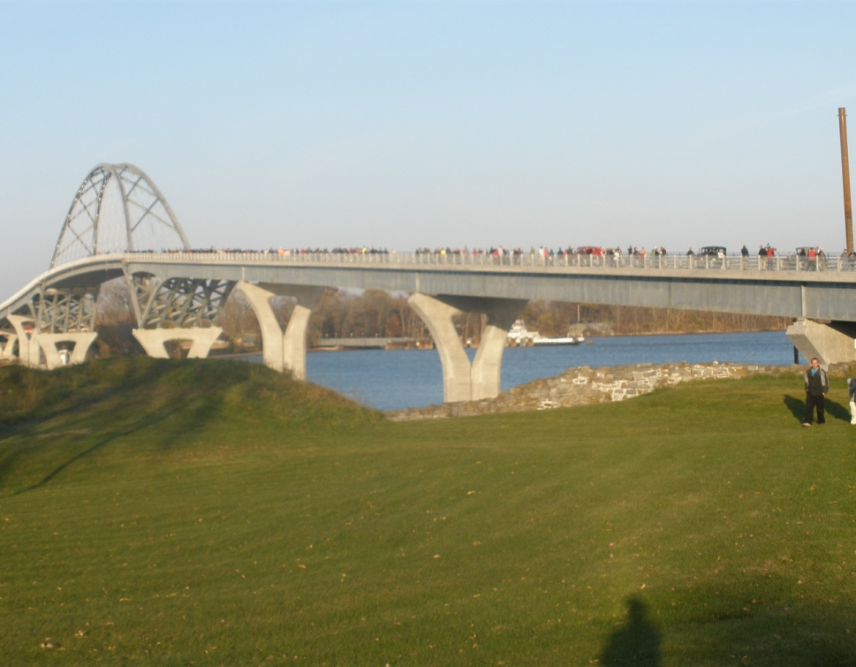
The Present
2011 Lake Champlain Bridge
Designed by Theodore P. Zoli of HNTB Corp. Renowned designer of Stayed cable bridges
Princeton & Columbia Faculty and recipient of the 2009 McArthur Fellows Program
2200 feet long Modified Network Tied Arch
400 foot Modified Tied Arch main span
7 short (240’ – 250’) steel girder spans
75 feet typical clearance over water

Slide 32
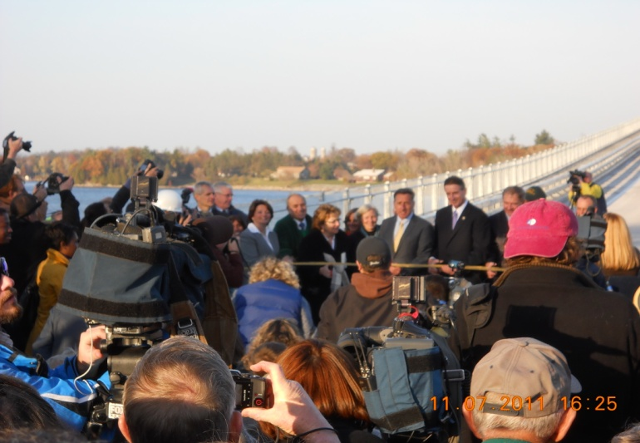
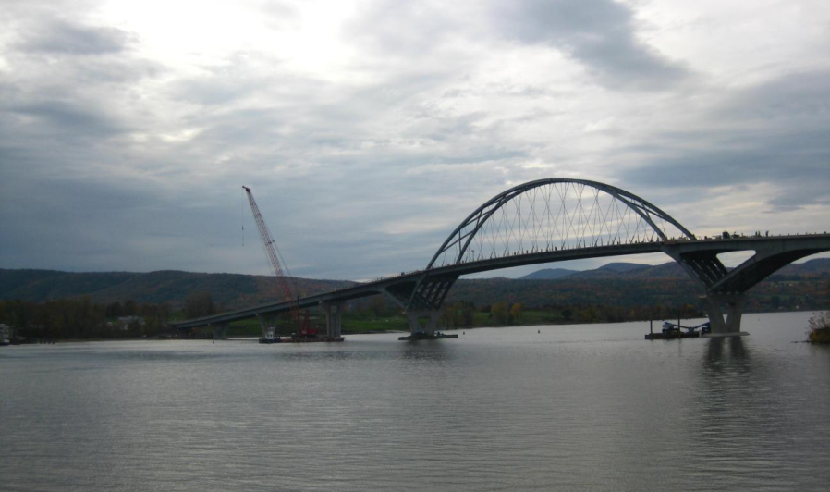
Opened to traffic on November 7, 2011 after only
17 months of construction
Original total cost of Bridge $ 69.7 M
Original total cost of all projects $ 132 M
New York will maintain but ownership remains
both New York and Vermont

Slide 33
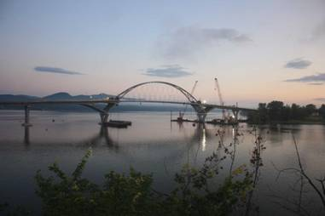
A Few Construction Pictures

Slide 34
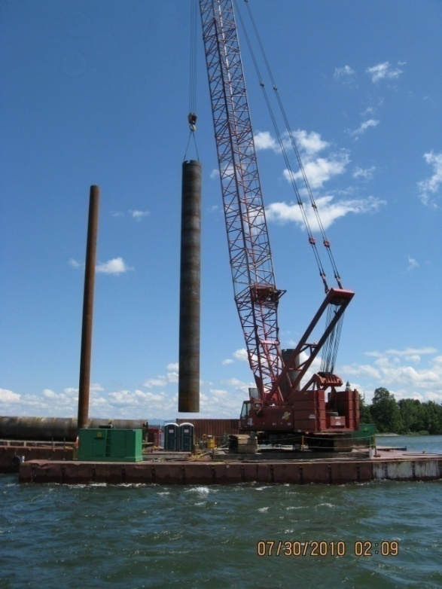
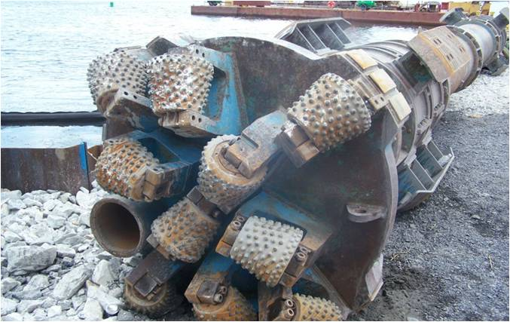
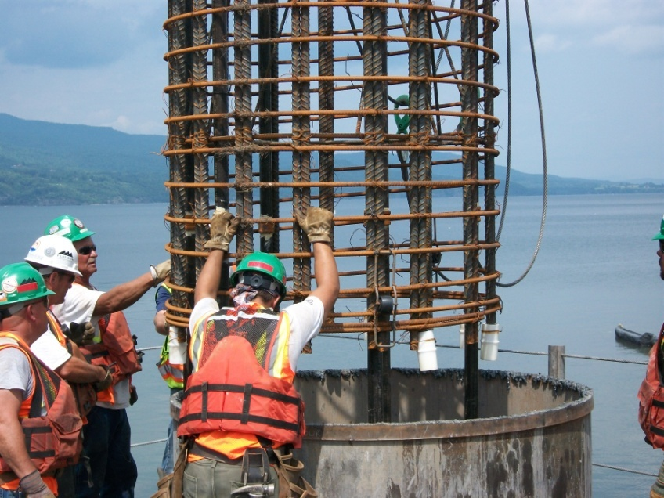

Slide 35
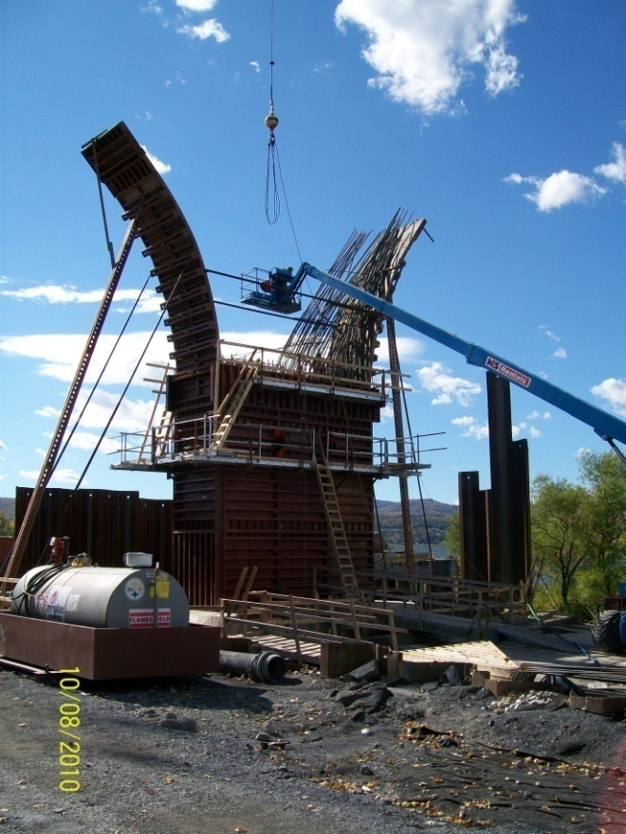
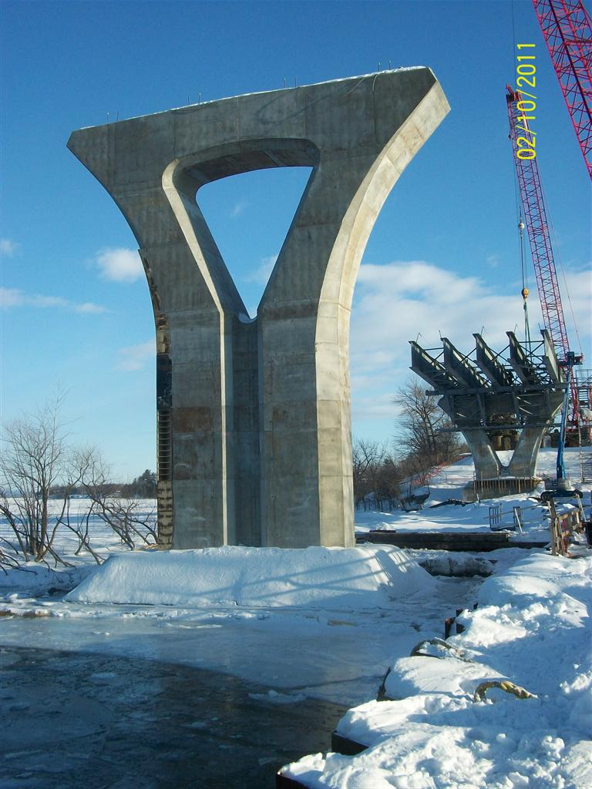
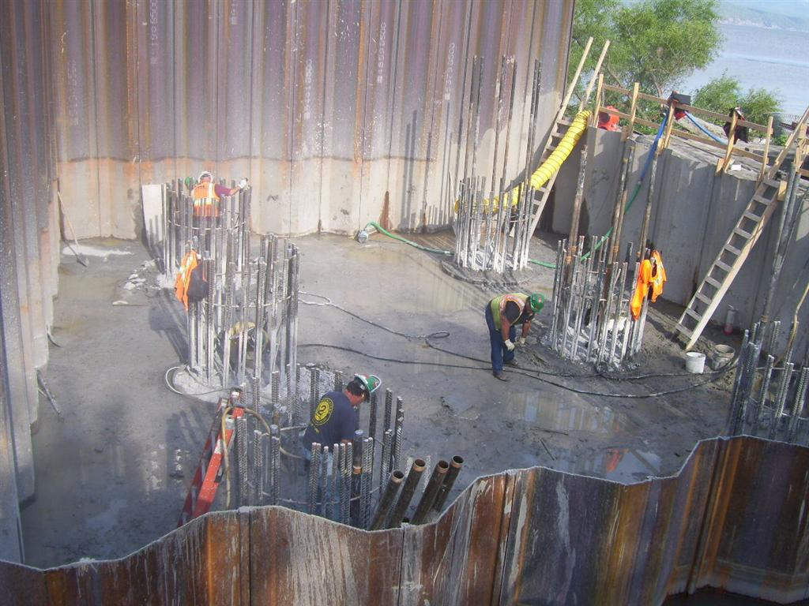

Slide 36
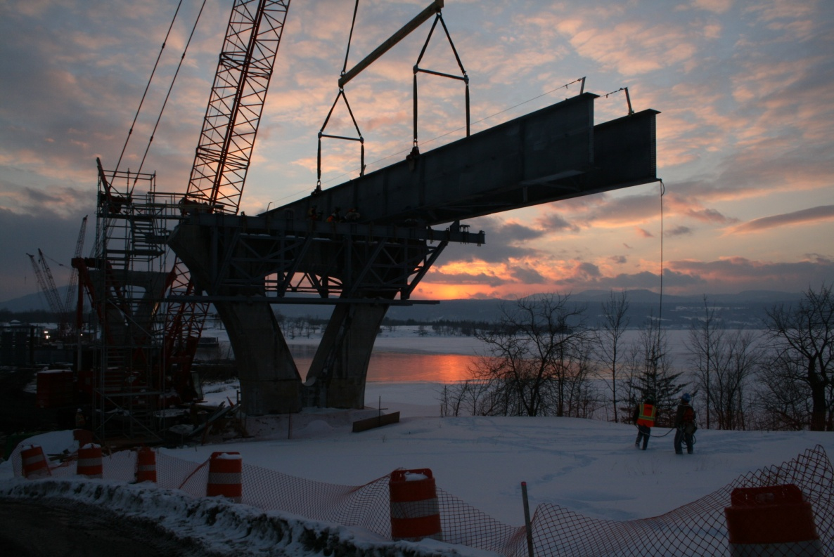
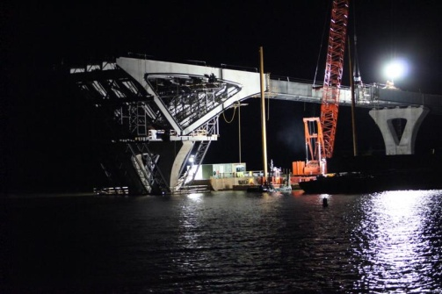

Slide 39
The Heavy Lift

Slide 41
The Future of the Lake Champlain Bridge Project
Restoration
Restoration

Slide 44
THE COMPLETED BRIDGEA

Slide 45
For Additional Information Go To;
https://www.nysdot.gov/lakechamplainbridge
Live Webcam
https://www.nysdot.gov/lakechamplainbridge/bridgecam

Slide 46
QUESTIONS

